Slide 1
Project Title
Write less; please more pictures! Remove this box!
Senior Design Project Proposal
names
Sonoma State University Department of Engineering Science
Advisor: name
Client: name
Web page
Date
yourwebpage.weebly.com
youremail@gmail.com

Slide 2
Overview
Problem, existing works, and Solution
General System Overview
In Depth System Description and Technical Components
Sensors, Controllers, Server
Tests and Results
Materials and Costs
Timeline / Schedule
Potential Risks
Conclusion

Slide 3
The Problem
What is the problem
Attention:
Throughout this document
All your FONTS must be consistent!
Pay attention to your splng and grmr!

Slide 4
The Proposal
What do you propose?

Slide 5
Existing Solutions
What are the existing solutions?

Slide 6
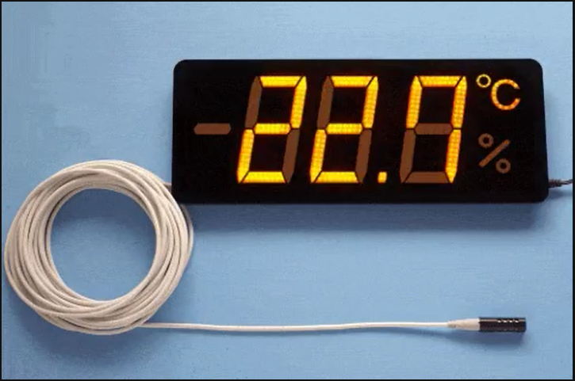
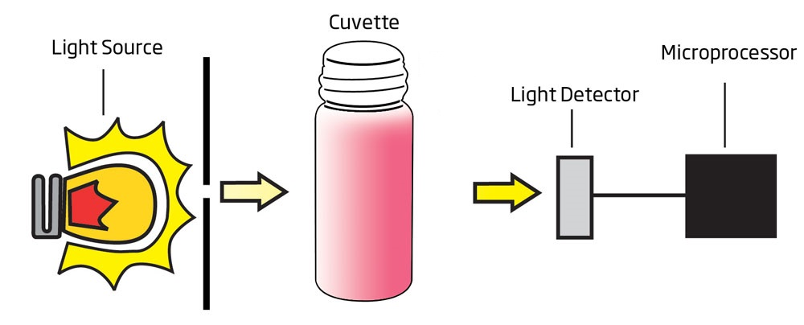
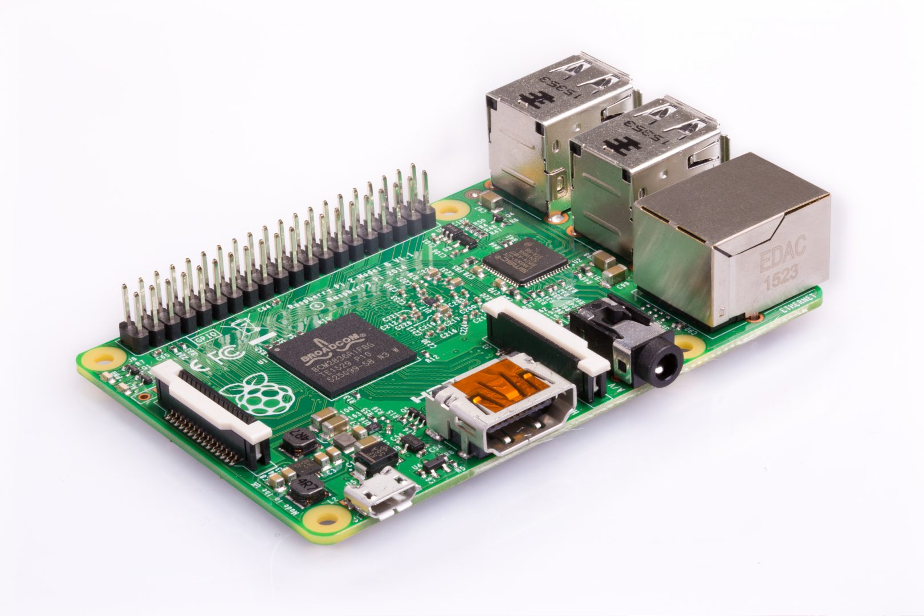
Basic Implementation Of your System VERY high-level block diagram
Proposed Solution
COLOR DETECTION
BASE STATION
6

Slide 7
Marketing Requirements
Highlight the most important ones
kkkllk
7

Slide 8
Engineering Requirements
Highlight the most important ones
kkkllk
8

Slide 9
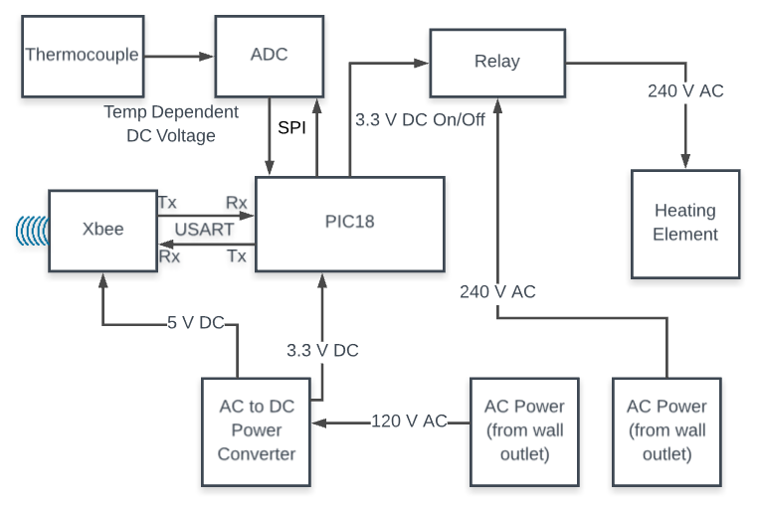
Explain How the system works – Very high-level diagram diagram
System Overview

Slide 10
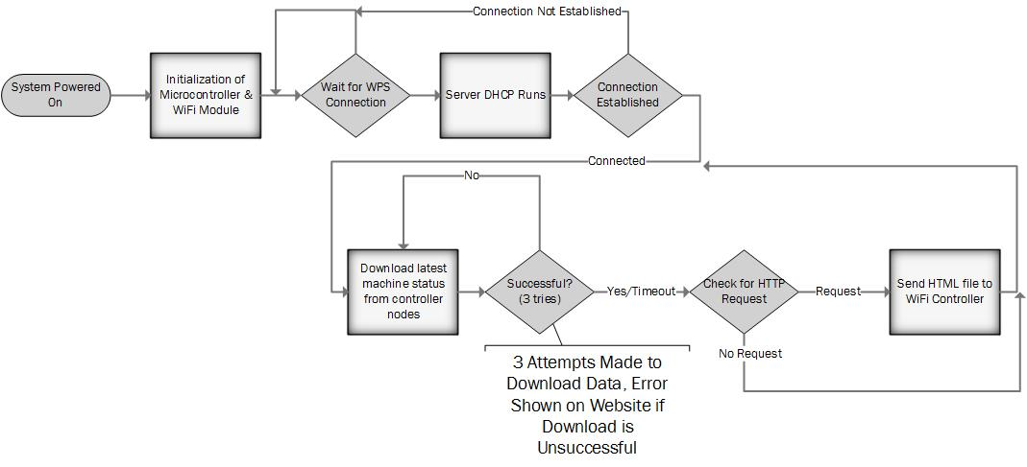
Show flowchart of the software
Software Design

Slide 11
Design Challenges what are your plans if these did not work?
Challenges & Risks

Slide 12
Summery of Tests Conducted
Test Number | Test Objective | Related ER | Status | Notes
FT.1 | Measured power consumption | ER.2 & ER.4 | Completed | Expected 3.2 Wh
FT.2 | Calculate the sampling rate | ER.4 & ER.8 | Completed | Expected sampling rate is 1 MS/s

Slide 13
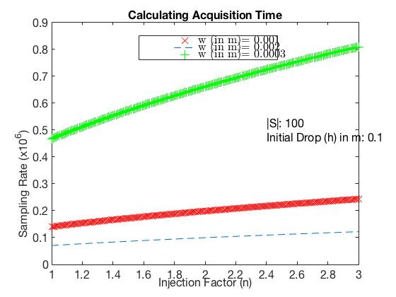
Simple calculation to estimate the minimum sampling rate requirement SR=ΔT/|S| - Using Matlab
Test Results –
Sampling Rate Estimation
Vi=0
h
V’i=Vf
ΔT
w
V’f
n
n.G
G=9.81 m/s^2
Samples Per ΔT:
S={v₁, v₂, v₃, … v_{n}}
|S|=Sample Size =n

Slide 14
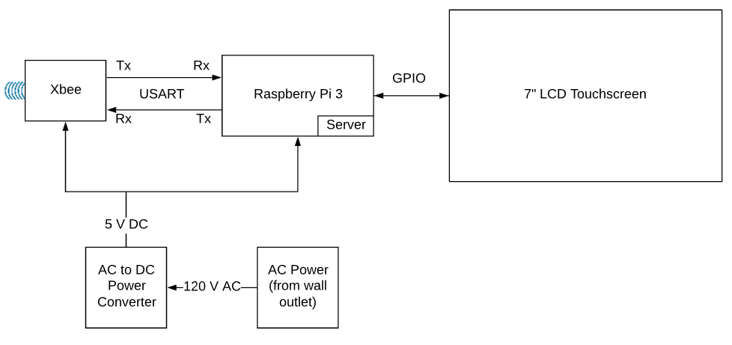
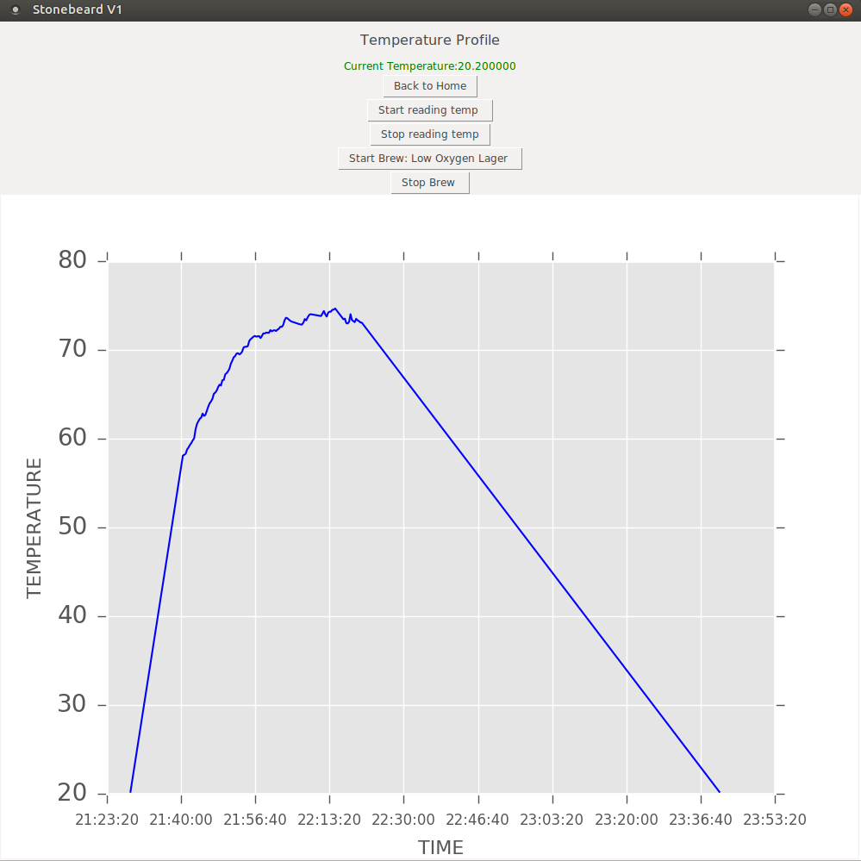
Test Results –
Power Consumption
What have
you tested so far?
EXPLAIN your results!
Results must be readable

Slide 15
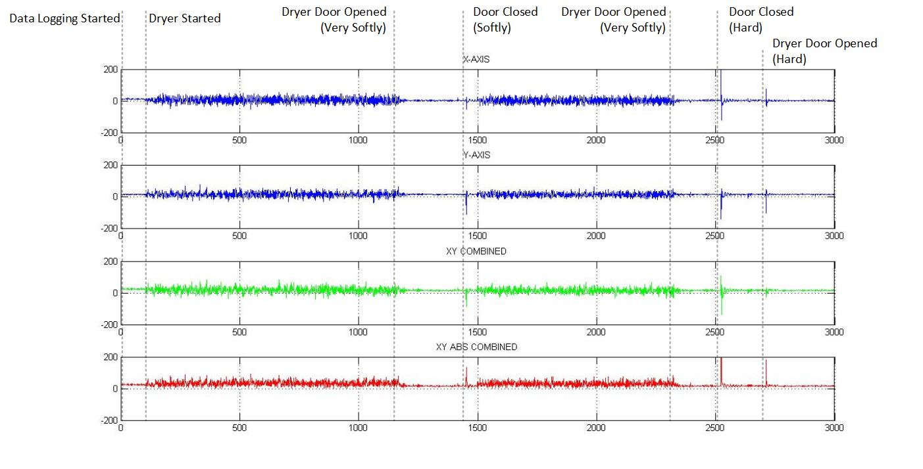
Test Results –
Activity Monitoring
EXPLAIN your results!

Slide 16
Estimated Budget
Include hardware & software – specify what is already available

Slide 17
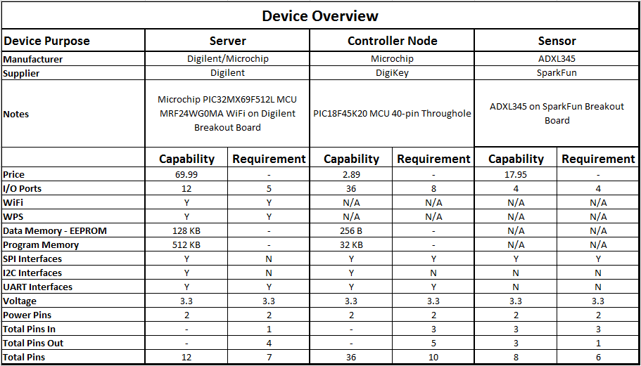
List of Components

Slide 18
List of Components
Highlight the key component!

Slide 19
Schedule

Slide 20
Schedule
Highlight the IMPORTNT DATES

Slide 21
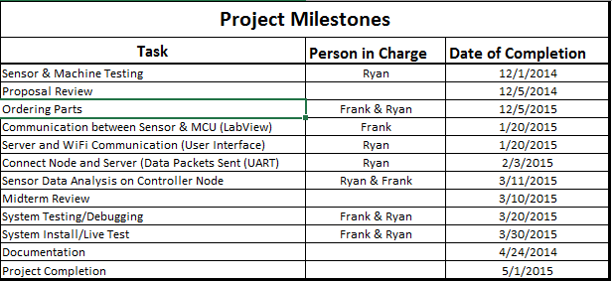
This is what you are committing to complete by January – be specific
Schedule –
Completed by January

Slide 22
Supported Courses
Programming (CS115)
Fundamentals of Logic Design (ES112)

Slide 23
Questions/Comments
Questions

Slide 24
References
http://www.macgray.com/
Mac Gray is the inventor and s

