Slide 1
CISCO Internet Operating System (ISO)

Slide 2
Internet Operating System
Routers or Switches run an operating system
Booted when the system is powered up
OS is on Flash or NVRAM

Slide 3
Some Industry Definitions
A Layer-3 switch (routing switch) is primarily a switch (a Layer-2 device) that has been enhanced some routing (Layer 3) capabilities
A router is a Layer-3 device that simply does routing
A switching router is primarily a router that may use switching technology (high-speed ASICs) for speed and performance and supports Layer-2 bridging functions.
Generally, SWITCHING refers to hardware-based switching (layer 2)

Slide 4
Switch Examples
Layer-2 switches
Cisco: Catalyst 2950, 2960 series
Layer-3 switches or routing switches (also referred to as Bridge)
Cisco: Catalyst 3550, 3560, 3750, 4500, 6500 series
Don’t confuse older Cisco Catalyst 3500XL series switches with the 3550 series
For example, the 3500XL series includes models 3524 (24 port) and 3548 (48 port).
Cisco names all the 3550 models with exactly "3550" as 4 digits in the name, with additional digits to imply the number of ports – for example, 3550-24
Juniper: EX series
Routers (with some bridging and/or security features) or switching routers
Cisco: 1800, 1900, 2600, 2800, 2900, 3700, 3800, 3900, 7200, 7600, ASR 1000 series
Juniper: MX series, J series, M series
Devices you see in the lab

Slide 5
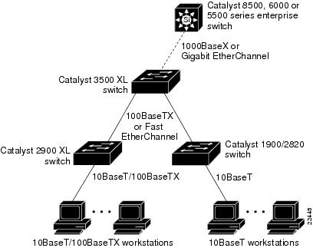
Laboratory Devices
Cisco 2651 XM Router
A 1-network module slot platform with 2 fixed 10/100BaseT Ethernet ports
We use 3500 XL Switches
Command reference:
http://www.cisco.com/en/US/docs/switches/lan/catalyst2900xl_3500xl/release12.0_5_wc6/cli/clicmds.html

Slide 6
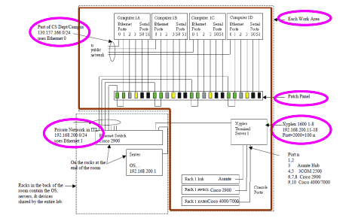
Laboratory Setup

Slide 7
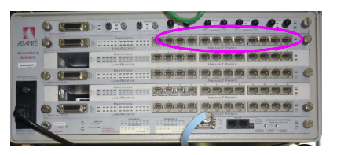
Interfacing the HUB and 3500 XL
Use
RED LAN Cable
(crossover)
Use
YELLO LAN Cable
Connecting to
the Terminal

Slide 8
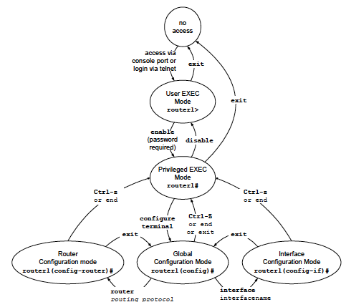
ISO Command Modes
Use Control ]
To exit

Slide 9
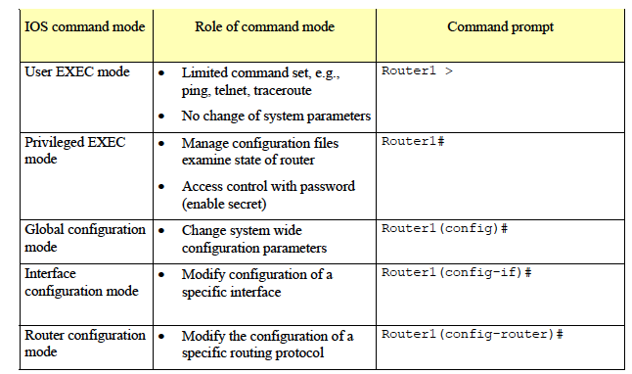
ISO Commands
Telnet to access
ENABLE to access
IP Address to each port / IP forwarding/Table entry
CONFIG TERMINAL to access
Interface Type, Slot #, Port #, ATM, Ethernet, Serial
INTERFACE to access
Routing Protocol Parameter: RIP, OSPF, BGP, etc.
ROUTER to access

Slide 10
Command Examples – Catalyst 3900 LX Switch
Ethernet Card
Slot 0
1
0
Switch1> enable
Switch1# configure terminal
Switch1(config)# interface Ethernet0/0 ← Interface name
Switch1(config-if)# no shutdown ← enable
Switch1(config-if)# ip address 10.0.2.1 255.255.255.0 ← IP & mask
Switch1(config-if)# interface Ethernet0/1 ← Slot 0 / port 1
Switch1(config-if)# no shutdown
Switch1(config-if)# ip address 10.0.3.1 255.255.255.0
Switch1(config-if)# end
10.0.2.1
255.255.255.0

Slide 11
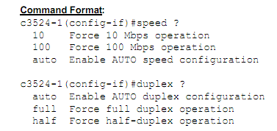
Command Examples – Catalyst 3900 LX Switch
Switch# show version
switch# conf t
switch(config)# host c3524-1
c3524-1(config)#
c3524-1(config)#interface VLAN1
c3524-1(config-if)#ip address 172.17.87.160 255.255.255.192
c3524-1(config-if)#exit
c3524-1(config-if)#interface FastEthernet0/24
c3524-1(config-if)#speed 10
c3524-1(config-if)#duplex half
c3524-1(config-if)

Slide 12
Communicating with the bridge/switch
Telnet to each bridge/switch
For example, the name (IP address) of the Xyplex terminal server and the port numbers for bridges in Work Area 1 are:
Bridge 1: xyplex1 (192.168.200.11) 2600
Bridge 2: xyplex1 (192.168.200.11) 2700

Slide 13
How to connect the PC directly to the Switch using Serial Interface
Connect the 9-pin serial interface on the PC directly to the Switch using a serial (BLUE) cable. You do not need any adaptors on the switch side.
Login as su
From command prompt, type: minicom -s
You need to setup the port first:
Go to SERIAL PORT SETUP and change serial device to /dev/ttyS0
Change Bps to 9600 8N1
Then, save the file as 3500cisco
exit (control A then q; you may need to press control z)
From command prompt, type: minicom 3500cisco

Slide 14
Command Example
Typical Interfaces:
FastEthernet0/0, FastEthernet0/1, Serial1/0, Serial1/1
Switch1#show protocols
Global values:
Internet Protocol routing is enabled
Ethernet0 is up, line protocol is up
Internet address is 10.0.2.1/24
Ethernet1 is up, line protocol is up
Internet address is 10.0.3.1/24
Serial0 is administratively down, line protocol is down
Serial1 is administratively down, line protocol is down

Slide 15
Practice
Switch-3# show version
Switch-3# show interfaces Ethernet0
Switch-3# show interfaces Serial0
Run show running-config in privileged EXEC mod
Switch# show running-config interface fastethernet 0/12
Switch> show diags
http://www.cisco.com/en/US/docs/switches/lan/catalyst2900xl_3500xl/release12.0_5_wc6/cli/clicmds.html

Slide 16
Password Recovery for 3500 XL
Switch Password Recovery (3500XL)
Power off the device.
Power the device on, while holding the button on the front left of the device. This will put you in rommon mode (switch:)
Type flash_init <Enter>
Type dir flash: to find the name of the config file
Type rename flash:config.text flash:config.old
Type boot

Slide 17
References
http://www.dslreports.com/faq/8347
3500 XL password recovery: http://www.youtube.com/watch?v=LXOp0M3_kb4
Manual for 2900 and 3500 XL http://www.net130.com/tutorial/cisco-px/Catalyst%202900-3500.pdf
Download TFTP: http://www.giveawayoftheday.com/soft/5374525/

