Slide 1
Using Breadboard

Slide 2
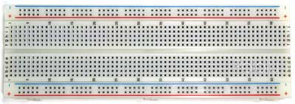
Breadboards
used to make up temporary circuits for testing or to try out an idea

Slide 3
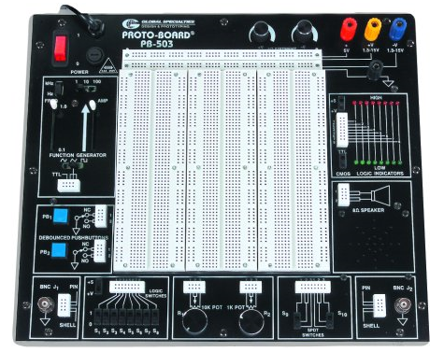

Slide 4
Using Breadboard
2
1
2
9
8
7
6
4
3
5

Slide 6
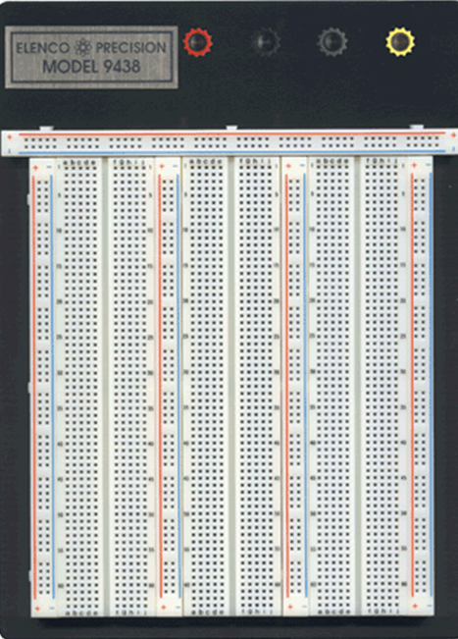
Typical Breadboard with power connections

Slide 7
Typical Breadboard – How connectors are arranged

Slide 8
Mounting components on the breadboard

Slide 11
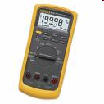

Slide 12
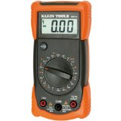

Slide 14
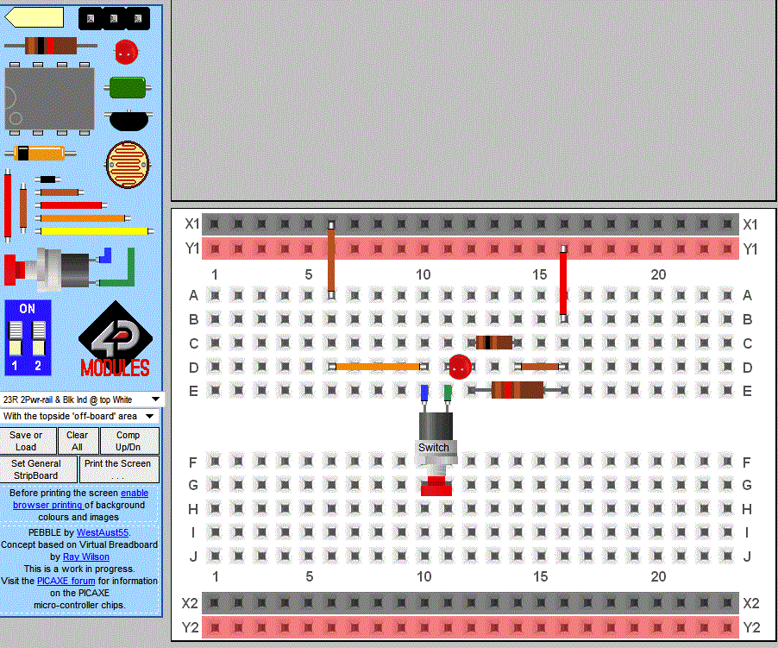
Example with Pebble Picaxe
Resistor: Brown/Red/Brown

