Slide 1
Team & Teamwork

Slide 2
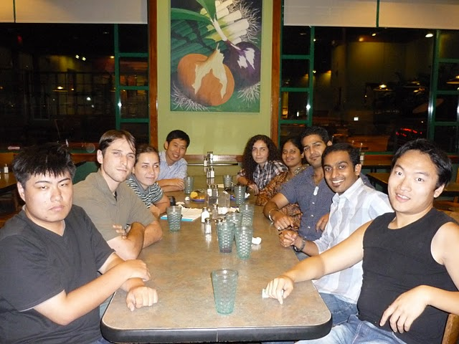
More Than Meets The Eyes!

Slide 3
Design Group
Engineering projects require diverse skills
This creates a need for group (team) work
  The larger the team the more complex relationships become: n(n-1)/2
What is a team
  Complementary skills
  Committed to a common goal/approach
  Accept accountability

Slide 4
Design Group
Models of team development
  Forming – creation
  Storming – develop objective
  Norming - accept roles and objectives
  Performing – achieve
  Adjourning – success and adjourn
Select members based on skills
  Technical
  Problem-solving
  Interpersonal

Slide 5
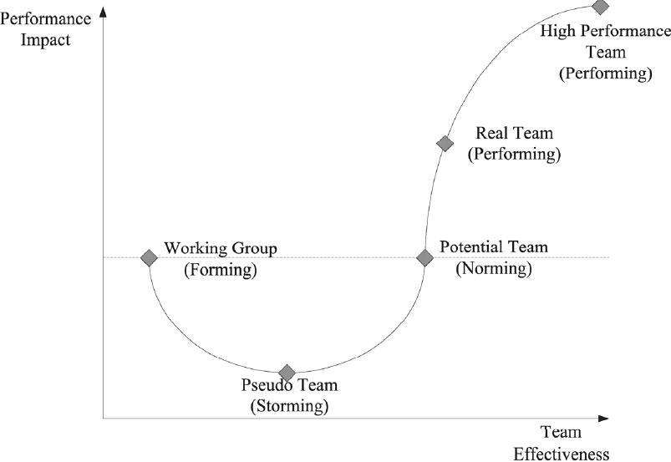
Team Performance Curve
Develop
Teamwork

Slide 6
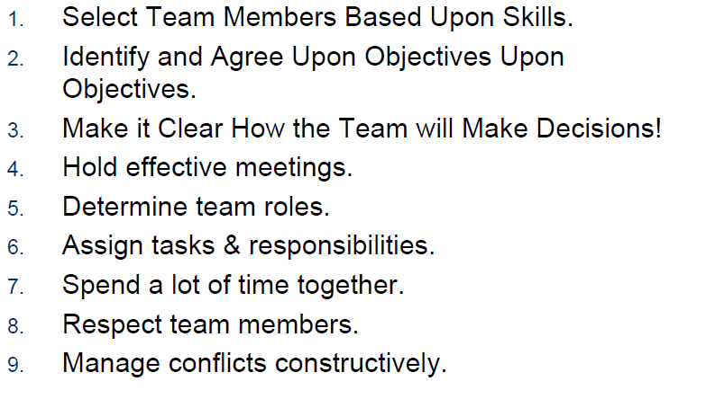
Real Team Characteristics

Slide 7
Design Group
Understand shared goals
  What is success?
Develop decision making guidelines
  Decision by authority (leader)
  Expert Member
  Average member opinion
  Majority
  Consensus
Normal Group Technique:
Members generate a solution; top idea wins!

Slide 8
Design Group
Teams that spend time together tend to be successful teams
  Learn about each other and accent!
Respect each other
  Listen actively
  Consider your response to others
  Constructively criticize ideas, not people
  Respect those not present
  Communicate your ideas effectively
  Manage conflict constructively

Slide 9
Design Group
Hold effective meetings
  Have an agenda
  Show up prepared
  Pay attention
  Schedule time and place of next meeting
  Summarize
Assign tasks and responsibilities
  Project management

Slide 10
Design Group
Team member roles
  Hardware
  Software
  Mechanical
  Leading
Find Strengths
  Leader
  Recorder
  Spoke person
  Optimistic
  Pessimistic (challenge ideas)
  Analyst (how things are going)

Slide 11
Design Group
Conflict Management
  Develop strategy
  Listen
  Mediate
Delphi Technique
  Provide a solution to the mediator
  Mediator makes a decision
  Feedback to mediator
  Revised mediator decision

Slide 12
Class Assignment
Do the survey sheet (next slide)
Develop team process guidelines:
Team’s name
Team’s mission and objectives: design problem statement
Decision making guidelines: how do you plan to finalize your decisions?
Meeting guidelines: How will you run your meetings?
Team roles: what are each team member skills?
Conflict resolution: how do you plan to resolve your conflicts?

Slide 13
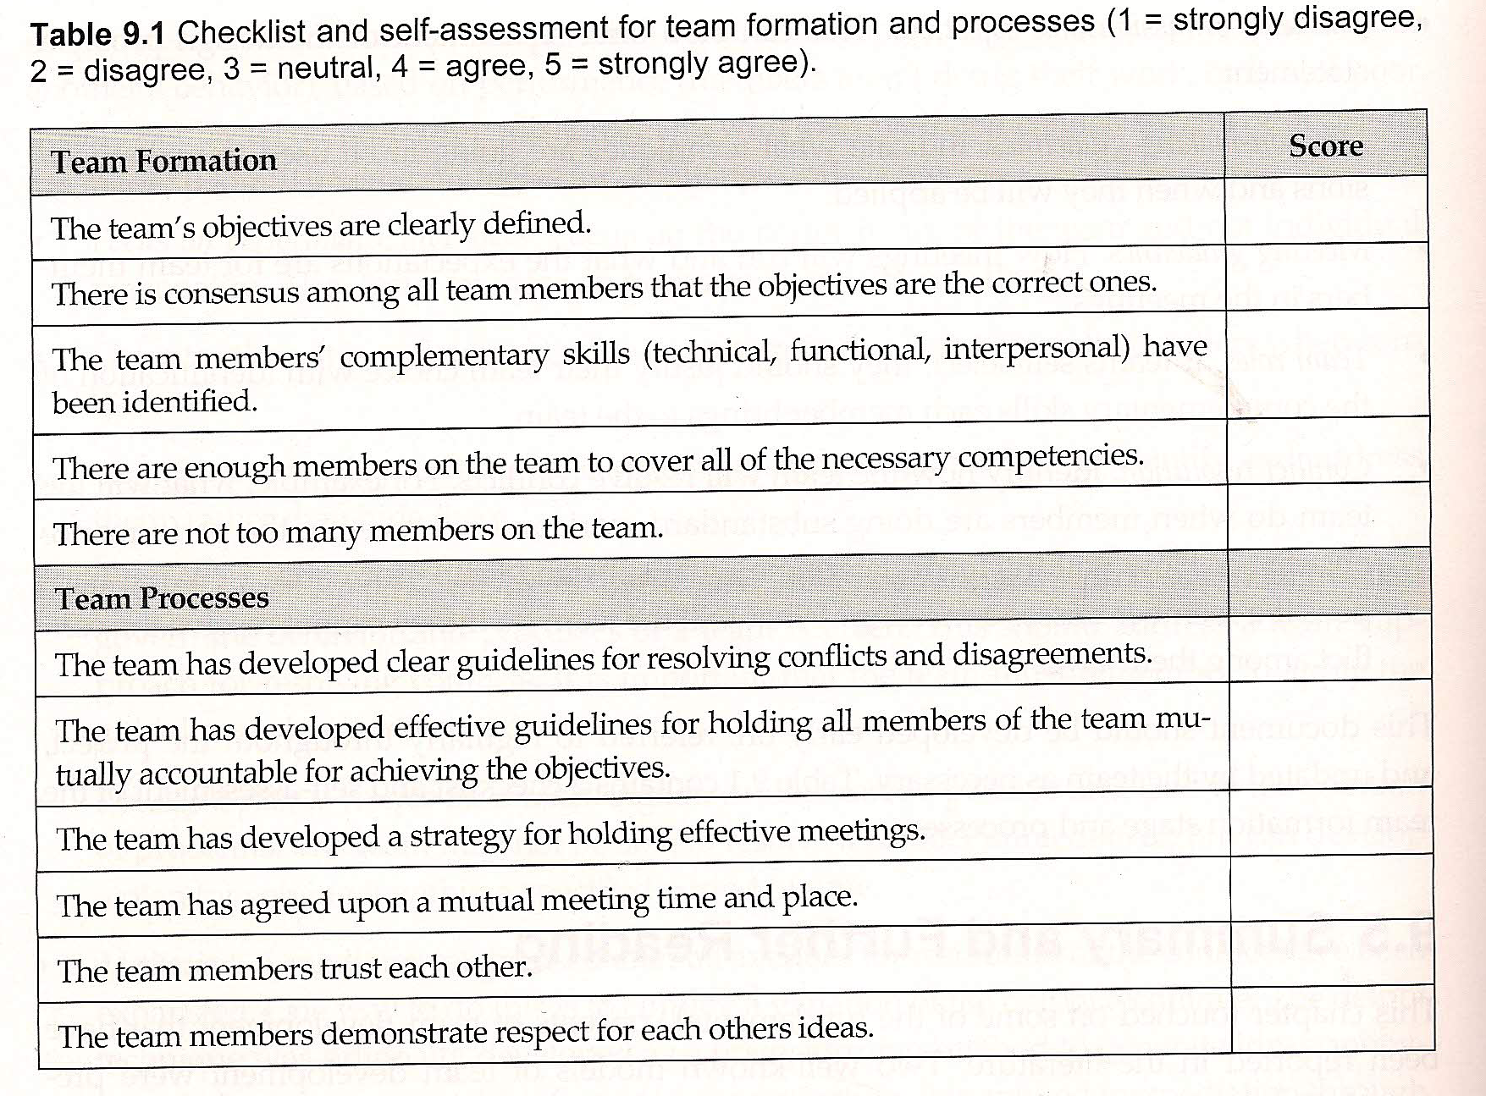

Slide 14
References
http://www.rose-hulman.edu/eceweb/ECE362/Lectures/ECE362/Smith-TPMS03.pdf : Teamwork and PRoject Management

