Slide 1
Project Management

Slide 2
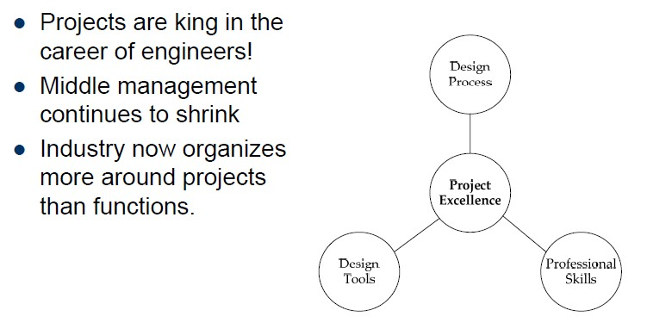
Motivation
Engineers have led the way on project management!

Slide 3
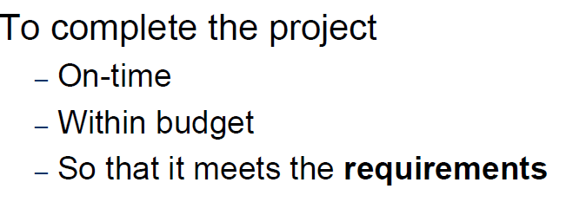
The Basic Idea

Slide 4
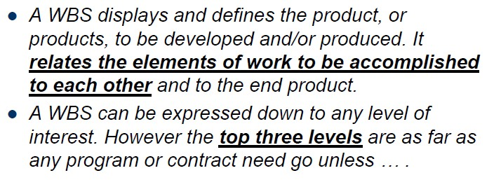
The Work Breakdown Structure
A WBS can be expressed down to any level of interest

Slide 5
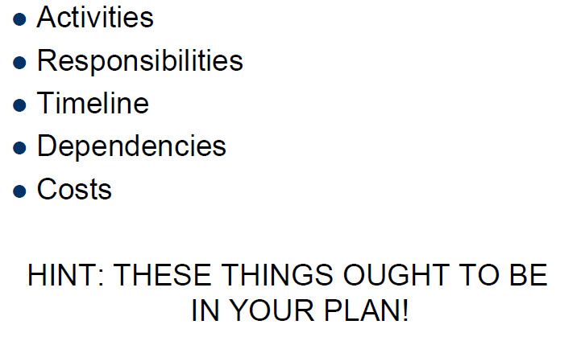
Elements of the Project Plan

Slide 6
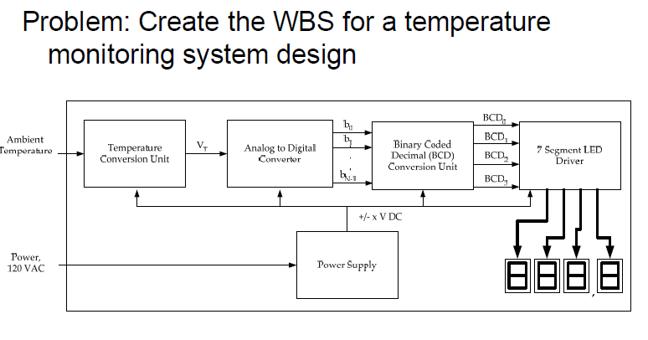
Example – Thermometer Design

Slide 7
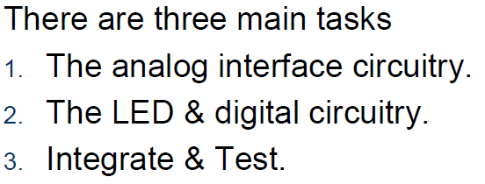
Example
4. Documentation
1- PCB Design
2- Packaging
3- Consult with customer
…..

Slide 8
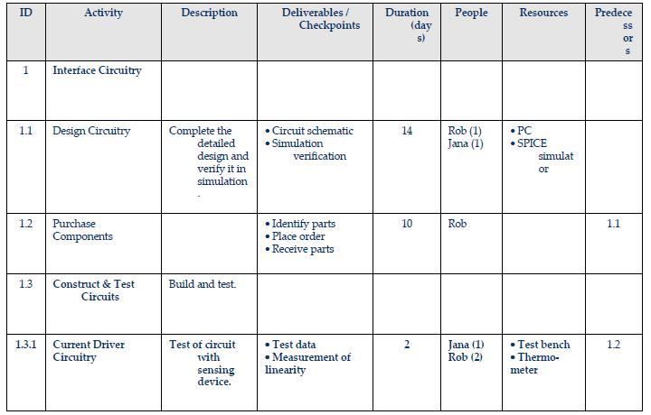
Activities

Slide 9
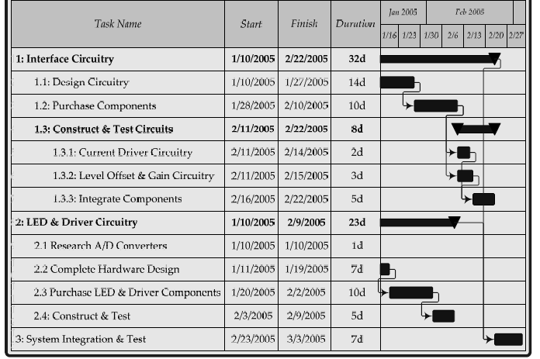
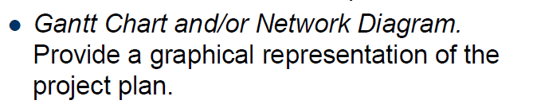
Gantt Charts

Slide 10
Creating a Gantt Chart
First step is defining your project plan structure. I suggest you to use this basic structure:
  Column A: Task ID (WBS) (an unique ID which identifies each task with a progressive number).
  Column B: Task description (a short description of the activity).
  Column C: Percentage of completion (0%-100%).
  Column D: Predecessor (finish-start relationships between tasks).
  Column E: Start date (task start date).
  Column F: Finis date (task finish date).
http://www.editgrid.com/ Or Google Gant Chart

Slide 11
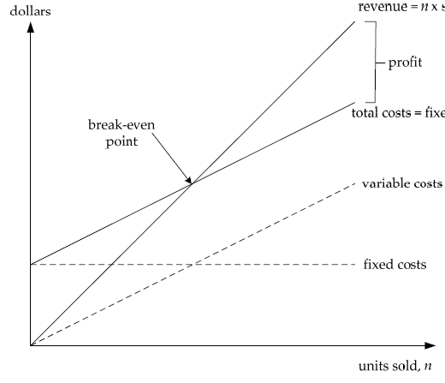
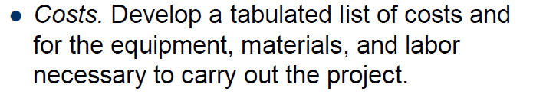
Constrain Analysis
Constrain
Max cost
Min cost
Performance
COSTS: Develop a tabulated list of costs for individual component,
Equipment (HW & SW), material, etc.

Slide 12
Consider Alternative Designs
Decision Matrix
 | Cost | Size | Complexity
Alternative | x3 | x1 | x2 |  | Total
A | 5 | 1 | 3 |  | 22
B | 3 | 1 | 5 |  | 20
C | 2 | 5 | 3 |  | 17
You need to be able to justify your choices:
Why are you using RPi?
Why are you using XCD Camera?
Why do you need a PIC processor?

Slide 13
Important Steps In Project Management

Slide 14
Important Steps In Project Management
1- What are you doing?
Define it - what is / what is not your goal
Set the goals and scopes
Assumption
2- Does it make sense / commercial sense
Cost-risk analysis
Your values and your project
3- How do you tell if the project is successful
Are your stakeholders happy
Are they engaged? Do you learn from them
4- How do you deliver the project
Identify the task and duration
Responsibilities / resources / the time lines / budget
5- Engage the team
6 - Be prepared / have plan B - identify the risk
What is your plan if something did not work
7- During implementation monitor your performance -don’t get stuck
Test everything
8- Close the project in orderly way
Deliver / handover all the documents
Make sure you document everything

Slide 15
Traditional Waterfall model
http://istqbexamcertification.com/what-is-agile-methodology-examples-when-to-use-it-advantages-and-disadvantages/

Slide 16
Agile development methodology

Slide 18
Homework
•Include a high-level schematic for your project
•Do a Gantt Chart for your project
•Describe 3 alternative designs (do the decision matrix for each case)
•Design test plans for 5 different functionalities – assign responsibilities to each test
•Have a web page link to your project
•Identify 5-10 risks and describe your contingency plan for each
•Identify 5-10 major technical issues and describe how each can impact the design

