Slide 1
Project Title
Write less; please more pictures!
Senior Design Project Proposal
names
Sonoma State University Department of Engineering Science
Advisor: name
Client: name
yourwebpage.weebly.com
youremail@gmail.com

Slide 2
Overview
Problem and Solution
General System Overview
In Depth System Description and Technical Components
Sensors, Controllers, Server
Testing and Results
Materials and Costs
Timeline
Potential Risks
Conclusion

Slide 3
The Problem
What is the problem

Slide 4
The Proposal
What do you propose?

Slide 5
Existing Work
Summary of what exists

Slide 6
Basic Implementation Of your Sysytem
Proposed Implementation

Slide 7
Explain all the parts – diagram
System Overview

Slide 8
Design Challenges
Challenges & Risks

Slide 9
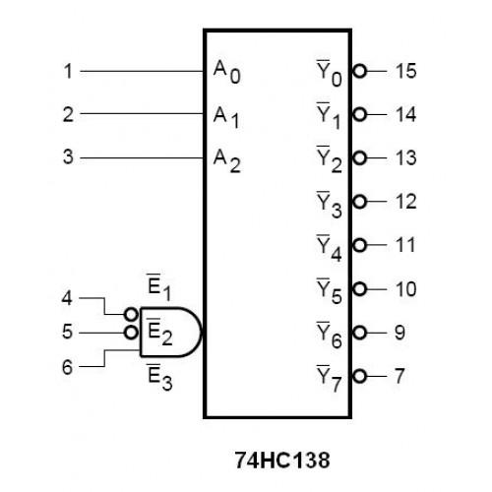
Short Circuit Diagram
Hardware Design

Slide 10
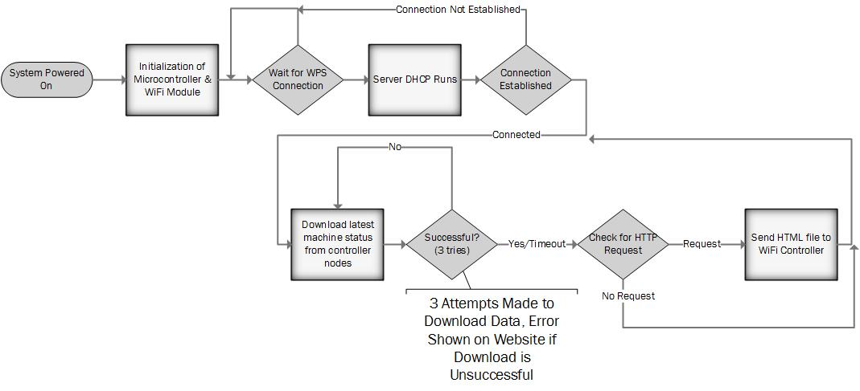
Show flowchart of the software
Software Design

Slide 11
Current Test Results
What have you tested

Slide 12
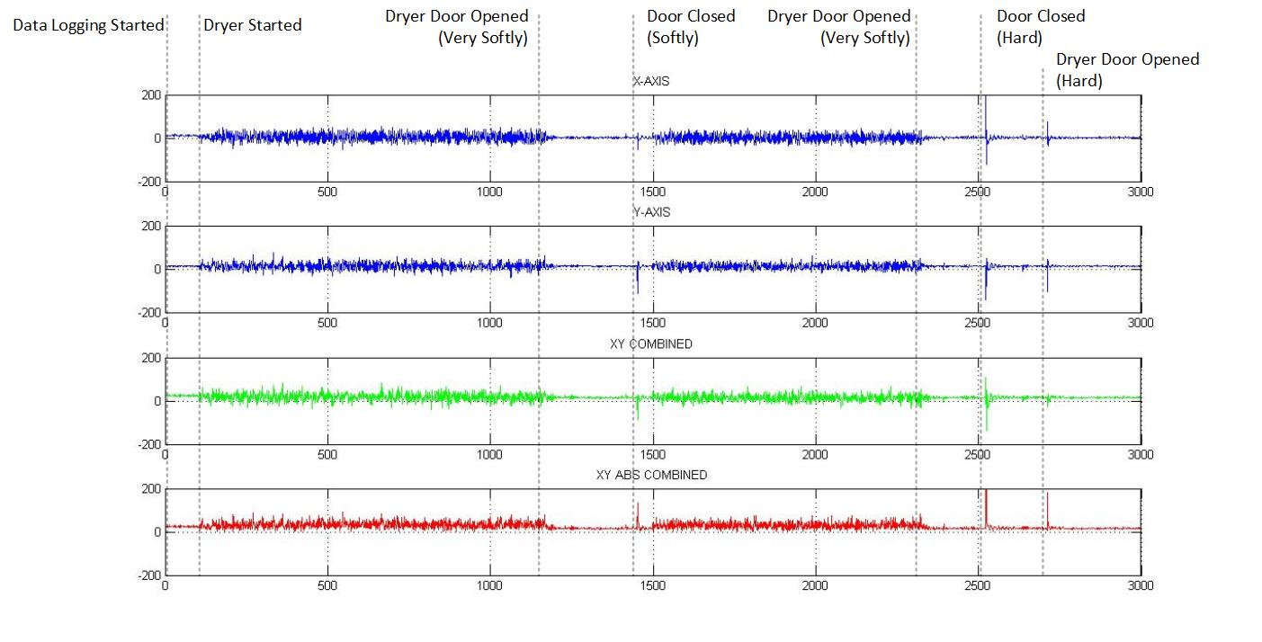
Test Results

Slide 13
Estimated Budget

Slide 14
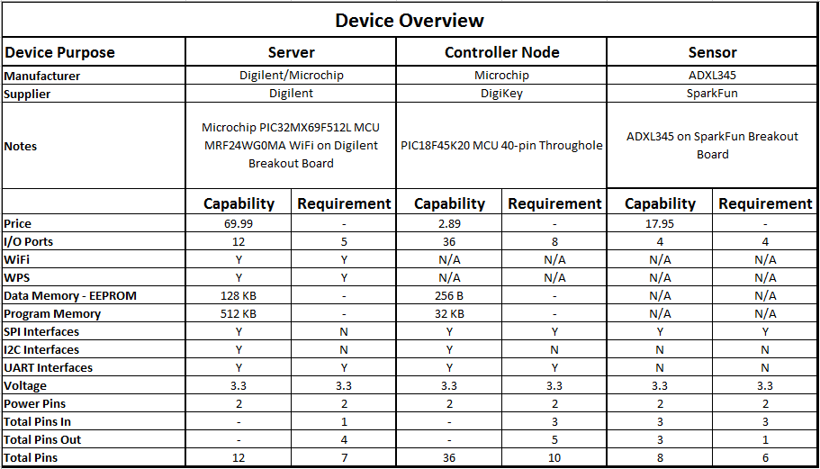
List of Components

Slide 15
Schedule

Slide 16
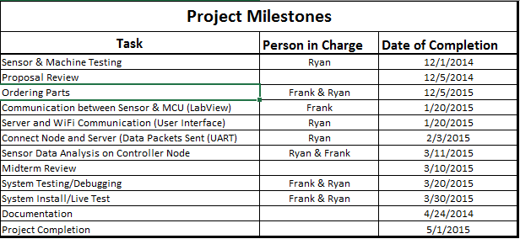
Project Milestones
Schedule

Slide 17
Supported Courses
Programming (CS115)
Fundamentals of Logic Design (ES112)

Slide 18
Questions/Comments
Questions

Slide 19
References
http://www.macgray.com/
Mac Gray is the inventor and s

