Slide 1
Introduction to SONET

Slide 2
Optical Networks
Networks using optical fiber can be thought as client layers of optical layer
Backbone
Access
Metro
Backbone optical fiber client layers
SONET / SDH
Ethernet
Optical Transport Network

Slide 3
Other Client Layers - Metro
Gigabit Ethernet
10-Gigabit Ethernet
Fibre Channel (storage network)
Resilient Packet Ring (RPR) – packet traffic
SONET/SDH

Slide 4
SONET/SDH
SONET/SDH: first generation of optical networks deployed in backbone networks
Supports constant bit rate (CBR) connections
Multiplexes CBR connections into higher speed optical connections by using time division multiplexing
Originally designed for low speed voice and CBR connections, up to 51 Mb/s
Supports data network, packet traffic that can have link transmission rates in the tens of gigabits per second.
It provides carrier grade service of high availability

Slide 5
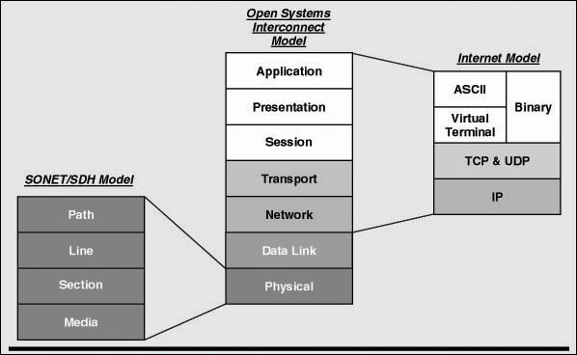
SONET Layers

Slide 6
SONET/SDH
Synchronous Optical Network
Transmission and multiplexing standard for high-speed signals within the carrier infrastructure in North America
SDH (Synchronous Digital Hierarchy), has been adopted in Europe and Japan

Slide 7
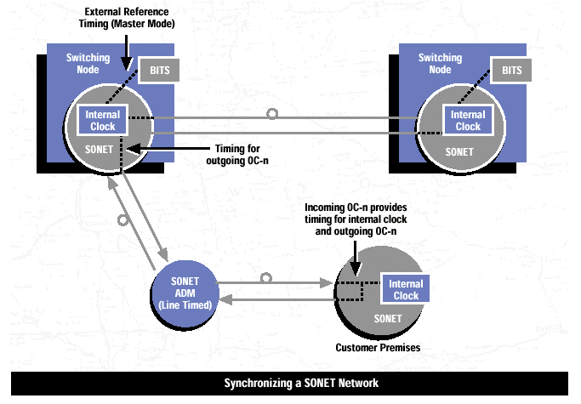
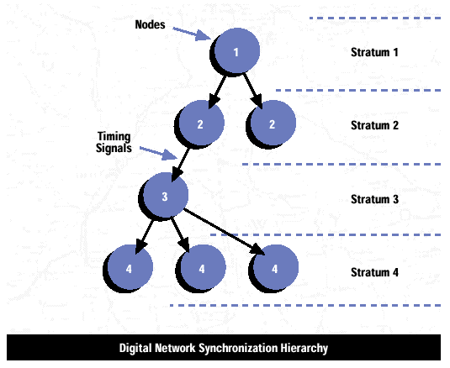
SONET Timing
http://people.seas.harvard.edu/~jones/cscie129/nu_lectures/lecture12/sonet/sonet.html

Slide 8
Synchronization vs. Plesiochronous
Plesiochronous digital hierarchy (PDH)
Known as asynchronous digital hierarchy in North America
Used for multiplexing digital voice circuits
4KHz Bandwidth
Sampled at 8KHz
Bit rate of 64 kbps (basic stream)
Higher speeds are achieved by multiple of basic stream
In North America the basic voice rate is called digital signal – n
E.g., DS0, DS1,
In Europe this hierarchy is labeled as E0, E1, E2, E3, & so on

Slide 9
Plesiochronous - Issues
Each system has its own clock (asynchronous) – nominal clock
Difference in clock can generate serious synch. Issues
20 ppm difference between clocks → 1.8 kbps bit rate difference
Bit stuffing is typically used to compensate for difference in transmission rates
Transmission rates are not exactly integral multiple of the basic rate (64 kbps)
DS1 (1.544 Mbps) > 24 x 64 kbps !
In order to extract lower rate the entire signal has to be demultiplexed – expensive!
Provides little/no management information including performance monitoring
Offers little standards for reliability

Slide 10
SONET / SDH Standards - Advantages
Higher bit rates are integral multiples of lower rates
All clocks are perfectly synchronized (via a master clock)
Incorporate extensive management information, e.g., performance monitoring
Provides interoperability between different devices by different vendors
Fast restoration time (much longer in PDH)

Slide 11
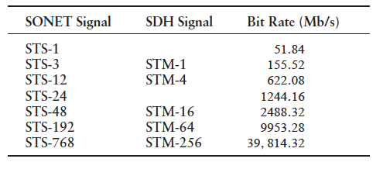
SONET / SDH Multiplexing
SONET basic rate is 51.84 Mbps
Called the synchronous transport signal level-1 (STS-1)
STS is an electrical signal
It uses scrambling (to avoid long runs of 1s and zeros)
Higher rate signals (STS-N) are obtained by interleaving N frames
No need for bit stuffing
Simple demultiplexing process
Optical interfaces of STS-N are labeled as OC-N

Slide 12
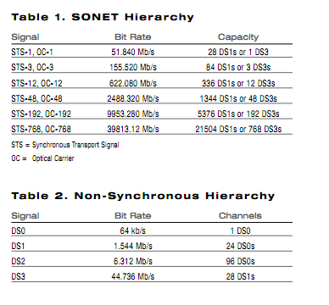
SONET Hierarchy

Slide 13
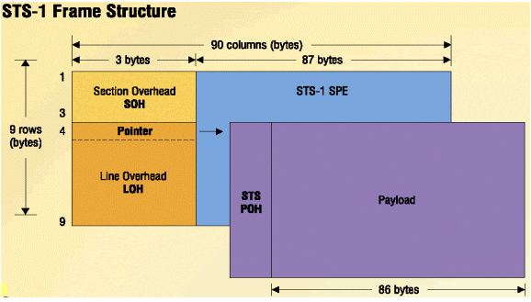
SONET Frame
SONET frame
Overhead bytes called transport overhead
Payload
STS payload is carried in synchronous payload envelope (SPE)
SPE contains additional path overhead
SONET uses pointers to indicate the location of the payload data within the frame
Clock phase differences can be compensated using pointer adjustments (no bit stuffing)
Pointer processing is complex!

Slide 14
Framing

Slide 15
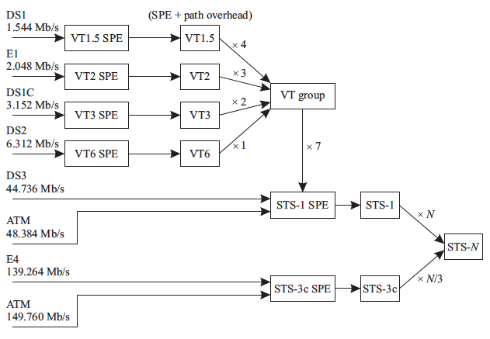
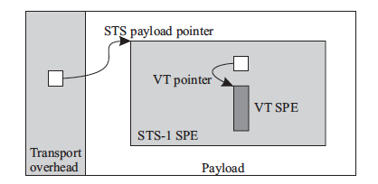
SONET Frame
Lower-speed non-SONET streams below the STS-1 rate are mapped into virtual tributaries (VTs)
Four VT sizes
SDH uses Virtual Container (VC) to accommodate for lower speed signals
SONET allows multiplexing lower-speed asynchronous streams into Virtual Tributary

Slide 16
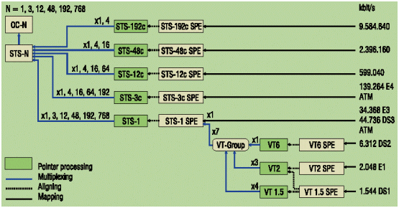
SONET Concatenation
An STS-Nc signal with a locked payload is also defined in the standards
The “c” stands for concatenated
N is the number of STS-1 payloads
The concatenated or locked payload implies that this signal cannot be demultiplexed into lower-speed streams
Example: 150 Mb/s client signal can be mapped into an STS-3c signal
How do we use SONET to carry Gigabit Ethernet?
Notes:
Use STS48c – 150 percent over provisioning!

Slide 17
Virtual Concatenation
Virtual Concatenation (VCAT) allows noncontiguous payloads to be combined as a single connection
Such a grouping is referred to as a virtual concatenation group (VCG)
The VCAT notation for SONET
STS-N -M v
N is the size of a member & M is the number of members in a VCG
Example: How do we carry GigabitE
STS-3-7V (155 Mbps x 7) about 1.05 (excluding the overhead) – 5 percent overprovisioning!

Slide 18
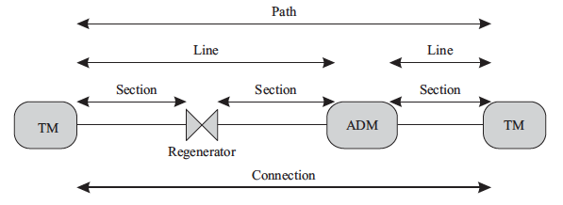
SONET Layers
SONET layer consists of four sublayers
path, line, section, and physical layers
Physical layer interfaces
Different rates
Electrical / optical
Distance (code):
Intraoffice (short reach) – I
Short haul 15km/1310 or 40km/1550 - S
Long haul 40km/1310 or 80km/1550 (400-600 km with Amplifiers) - L
Very long haul 60km/1310 or 120km/1550
ultra long haul 160km
Fiber type
Standard single-mode fiber (G.652)
Dispersion-shifted fiber (G.653)
Nonzero dispersion-shifted fiber (G.655)
The transmitter types
LEDs or multilongitudinal mode (MLM), single-longitudinal mode (SLM) distances
TM: terminal multiplexer (end-to-end) connection
ADM: Add/drop multiplexer
Different Physical Interfaces for SDH (similar for SONET)

Slide 19
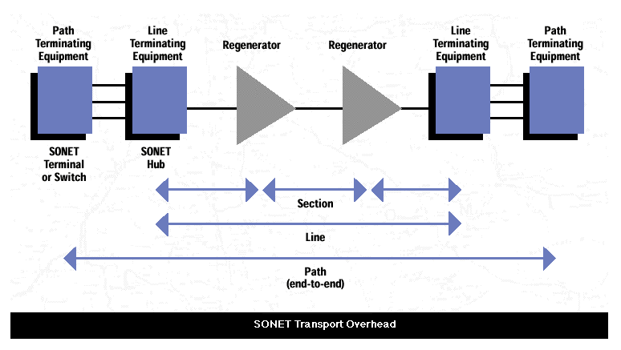
Physical Layer

Slide 20
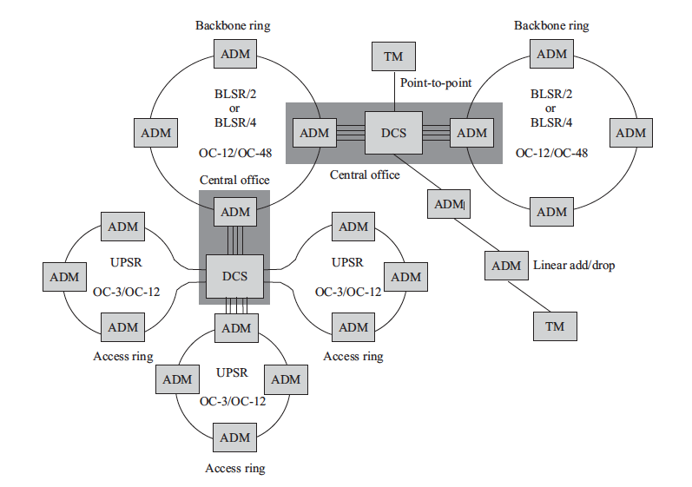
SONET Elements
ADM
Is connected to
TM
TM: terminal multiplexer (end-to-end) connection
ADM: Add/drop multiplexer
DCS: Digital crossconnect
LTE: Line Terminating Element
UPSR: Unidirectional path-switched rings
BLSR: Bidirectional line-switched rings (with 2 / 4 fibers)

Slide 21
SONET Elements
Traffics with the same destinations are groomed together
Unidirectional
Ring
ADM
Is connected to
TM
TM: terminal multiplexer (end-to-end) connection
ADM: Add/drop multiplexer
DCS: Digital crossconnect
LTE: Line Terminating Element
UPSR: Unidirectional path-switched rings
BLSR: Bidirectional line-switched rings (with 2 / 4 fibers)

Slide 22
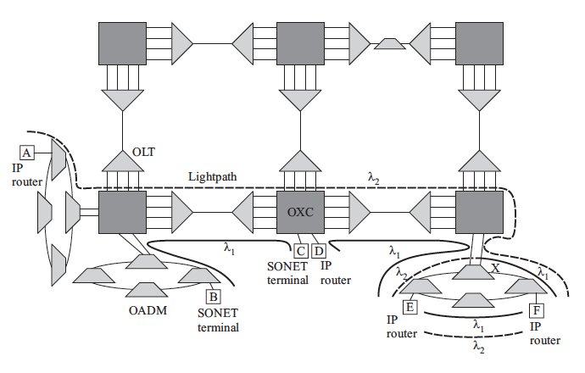
IP/SONET over WDM

Slide 23
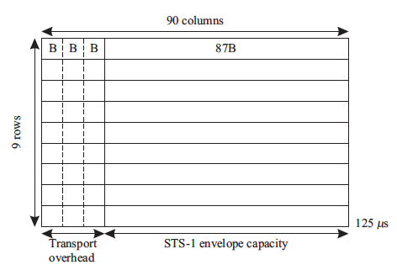
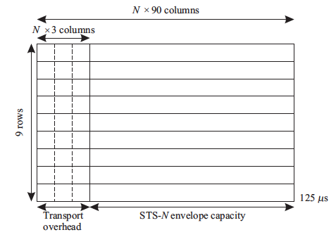
SONET Frame Structure
STS-1 frame is 125 usec (1/8000 sec/frame)
There are 810 bytes per frame
Transmission row-by-row, left-to-right, MSB first

Slide 24
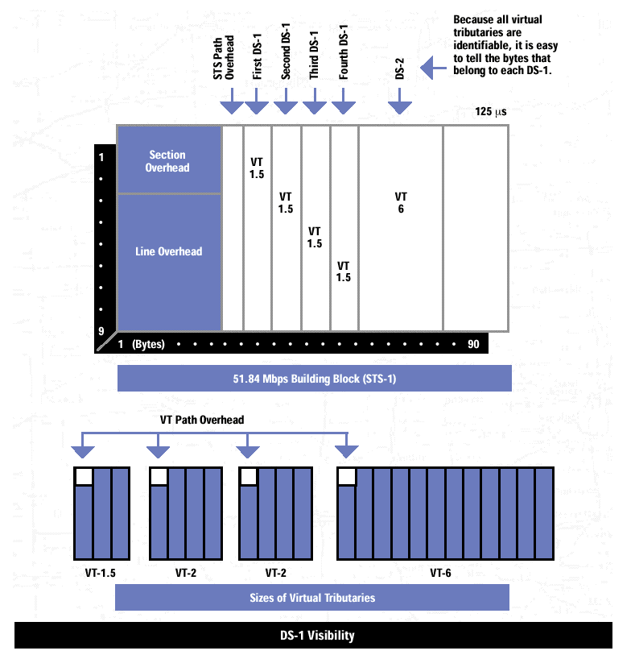
Frame Structure - Overhead

Slide 25
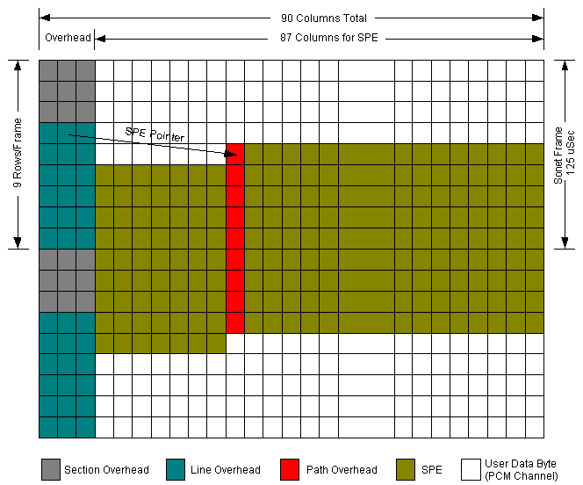
Use of Pointers – Pointer H2 Line Overhead

Slide 26
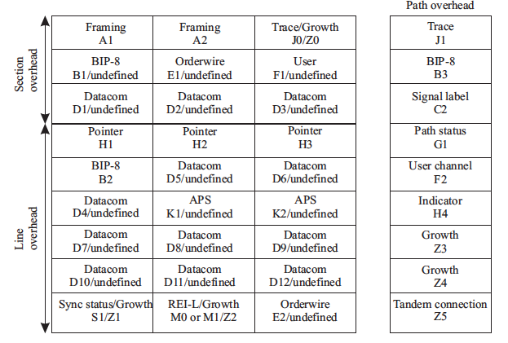
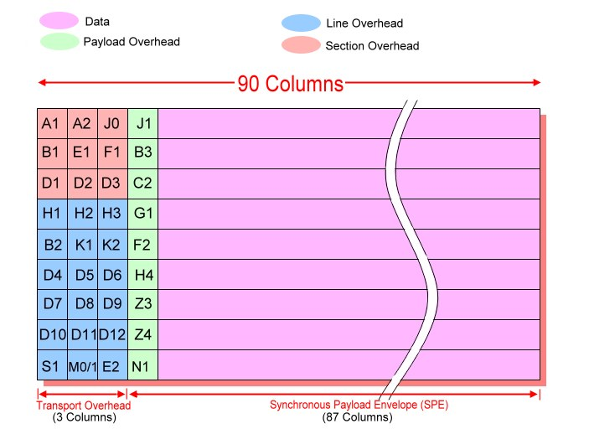
Frame Structure
A/A2: Network elements use these bytes to determine the start of a new frame
G1 is Yellow alarm to upstream nodes
K2 (FERF) alarm for upstream node
APS indicating automatic switching

Slide 27
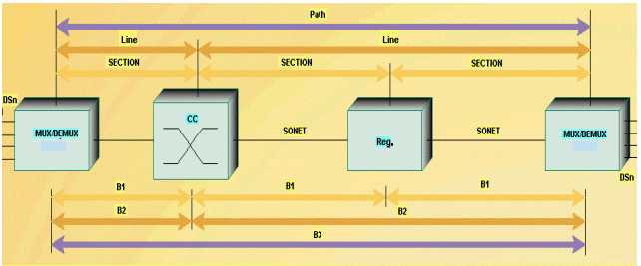
BIP-8 Errors
X/Y = X applies to the first STS-N; Y is remaining
Monitoring BIPs
Bit interleaved parity
Even parity
Calculated for the previous frame

Slide 28
Calculating BIP-8
Calculated BIP-8 (B1) is based on the previous STS-N frame after scrambling
Odd parity means there is an error
B2 is based on calculating line overhead of the line overhead – checked by the line terminating equipment

Slide 29
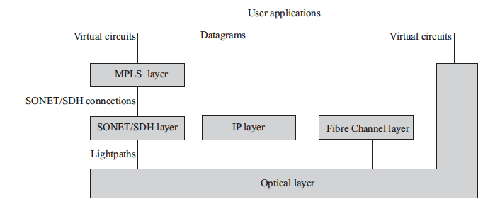
Client Layers of Optical Fiber

Slide 30
SONET Protection
Chapter 9 - up to 9.3

Slide 31
SONET Protection
Availability: A common requirement that the connection will be available 99.999%
Thus network has to be survivable
continue providing service in the presence of failures
Protection switching is the key technique used to ensure survivability
The term restoration to schemes where traffic is restored
There are many failures
Human errors / disasters / Attacks / etc.
Component failures
Link failures:
There are estimates that long-haul networks annually suffer 3 fiber cuts for every 1000 miles of fiber
For a large network of 30,000 miles of fiber cable, that would be 90 cuts per year

Slide 32
Protection Key Parameters
Detect failures
Protect against failures (single failures)
Restoration time (60 msec – including detection and restoration)
Topology (Ring / Mesh)
Signaling

Slide 33
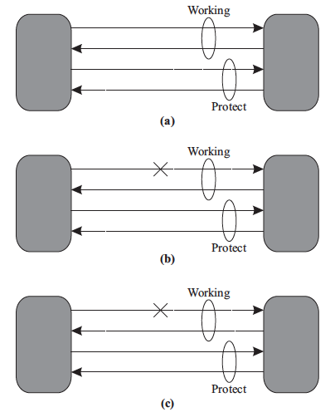
Basic Protection Concepts
Failures must be protected!
Failure types:
Single / multiple / double (a series of shared links can fail)
Failure example:
Node / Link (Fiber) / Components
Protection type
Shared
Dedicated
Scheme
Revertive – when shared protection is used
Non-revertive – when 1+1 is used

Slide 34
Protection Switching
Automatic Protection Switching (ASP)
Unidirectional
ASP Required
Signaling is required
Bidirectional
No ASP is required
Case b: Only affected direction is switched: - Unidirectional Protection switching (RED is working)
Case c: Bidirectional protection

Slide 35
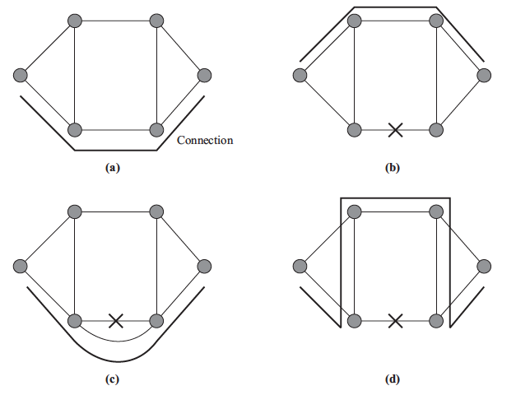
Traffic Routing Due to Protection Switching – how the traffic is being rerouted due to link failure
Path Switching
Ring Switching (rerouting on a ring)
Span Switching

Slide 36
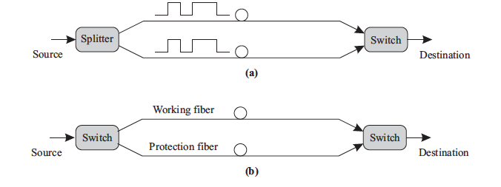
Protection Techniques
1+1 Protection / Simultaneous TX & RX)
1:1 Protection / Signaling is required
To activate the protection / traffic must be switched /
The protection links can carry EXTRA traffic – low priority

Slide 37
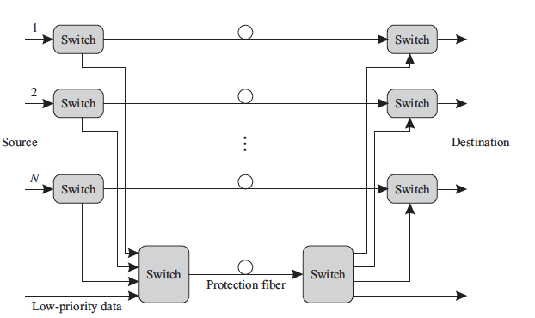
Protection Schemes
1:N Protection / Shared Protection / Signaling is required /
Typically, must be revertive!

Slide 38
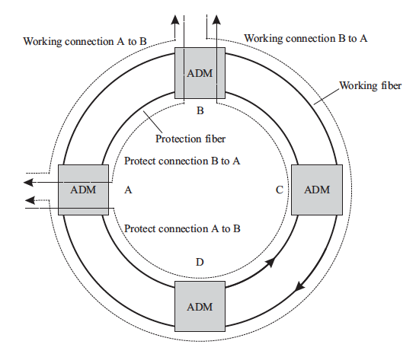
SONET Rings and Self-Healing Rings
Unidirectional path-switched ring (UPSR)
1+1 Protection
Two Fibers only
Unidirectional
Simultaneous traffic (clockwise and counter CW)
Path Layer Protection
Simple / requires no signaling
No node limitation / no length limitation
Note: It is important that the traffics
are moving in DIFFERENT directions
to protect against any node failure

Slide 39
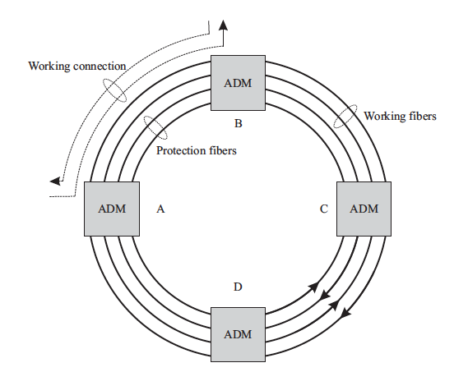
Four Fiber Bidirectional Lines Switched Ring (BLSR/4)
Mainly, line protection
Traffic is on both directions
CW and CCW
Max of 16 notes are supported
Max length is 1600 km
Supports span switching or ring switching (next slide)

Slide 40
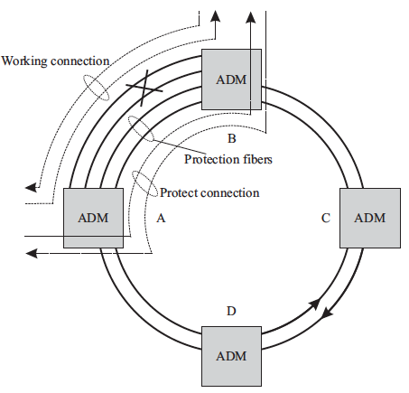
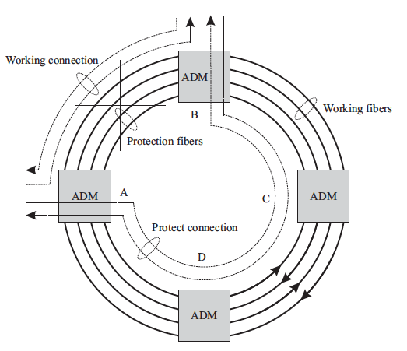
SPAN / RING Switching in BLSR/4

Slide 41
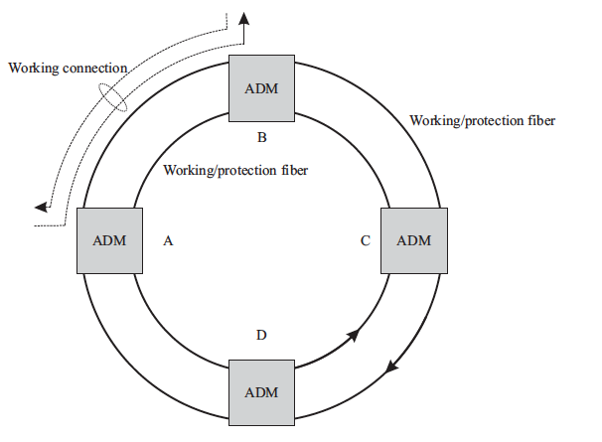
Two-fiber bidirectional line-switched Ring (BLSR/2)
k
Each link has half BW
Very complex – uses APS (K1/K2 bytes)
1:1 Switching
Used for long haul
Very common
Efficient use of special capacity

Slide 42
Example: BLSR/2 is much more efficient than UPSR (2 fiber)

Slide 43
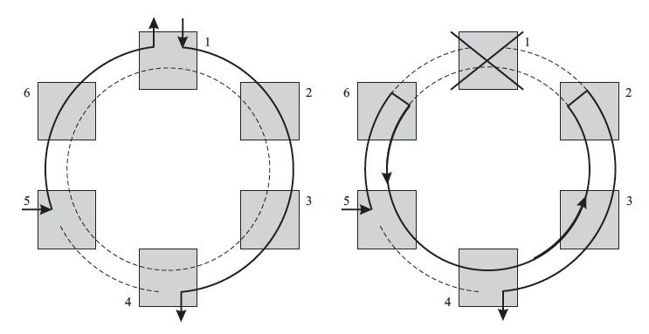
Node Failure

Slide 44
Lab

Slide 45
Framing Review

Slide 46
LAB
http://www.cisco.com/en/US/tech/tk482/tk607/technologies_tech_note09186a0080124afa.shtml#f1

Slide 47
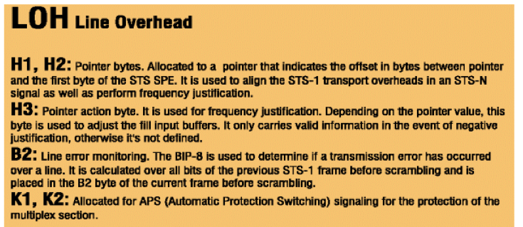
Framing Bytes

Slide 48
Connection Setup
Pseudo-random bit sequences – max 14 consecutive zeros

Slide 49
References
http://www.cisco.com/en/US/tech/tk482/tk607/technologies_tech_note09186a0080094313.shtml
http://www.opticus.co.uk/pdf/WhitePaper-Understanding_Error_Checking_Using_Parity_Bytes.pdf

