Slide 1
Introduction to JITTER

Slide 2
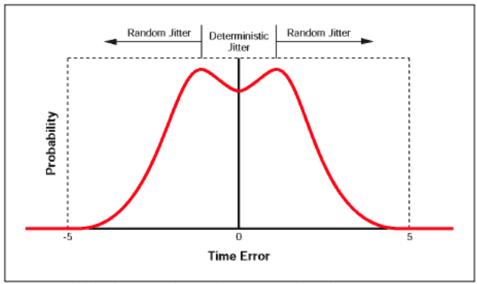
Timing Errors
Long term variation from the ideal position
Short term variation from the ideal position
The SONET standard states that "Jitter is defined as the short-term variations of a digital signal's significant instants from their ideal positions in time
Jitter Impact the BER
Jitter types
Random
Deterministic
Probability histogram showing deterministic and random components
Tail
This is bimodal
response

Slide 3
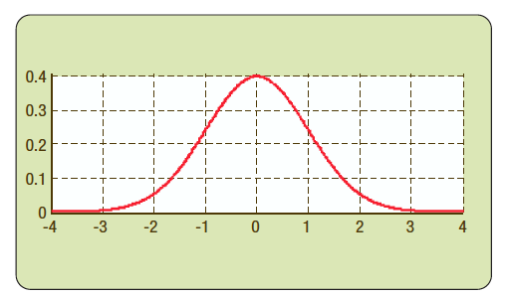
Random Jitter
Random Jitter is probabilistic
Not bounded
Has a mean and standard deviation
It is called Gaussian (normal distribution)
Has no pattern and is not periodic
Since it is random variable we need N samples
Mean: Mean Value: The arithmetic mean, or average, value of a clock period is the nominal period
Standard Deviation: The standard deviation, represented by sigma (σ), is the average amount by which a measurement varies from its mean value
RJ s measured based on Unit Interval
1 UI = 1 Period (seconds)

Slide 4
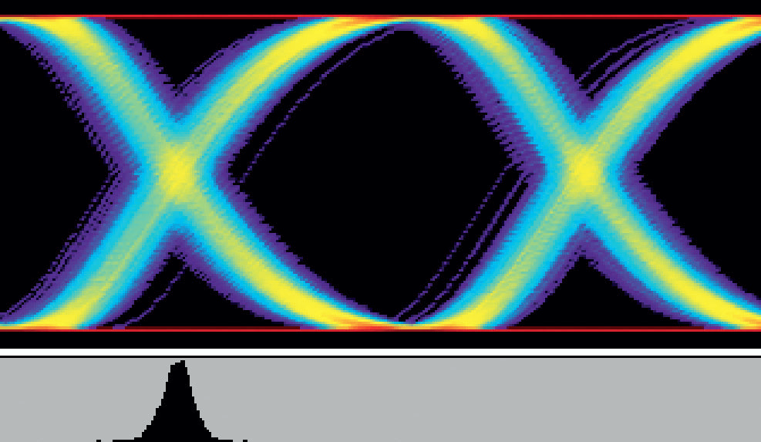
Random Jitter
Random

Slide 5
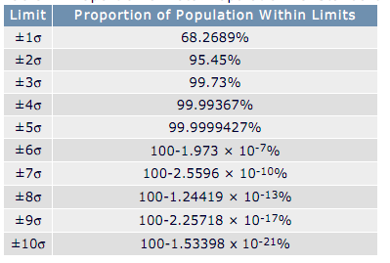
Random Total Jitter
Random Jitter that is not bounded and can be described by a Gaussian probability distribution
Random jitter is characterized by its standard deviation (rms) value
Gaussian distributions are symmetrical about a mean value.
One standard deviation (1σ) is defined as the window which contains 68.26% of a population to one side of the mean.
Each side of the population

Slide 6
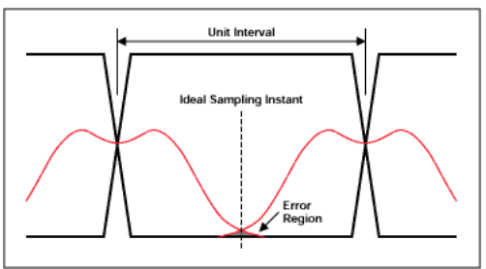
Ideal Time Diagram and Jitter
Jitter can result in error

Slide 7
Deterministic Jitter
Predictable
It is abounded
Due to source imperfections
Three sub-categories
Periodic Jitter (sinusoidal)
Data Dependent Jitter
Duty-Cycle Dependent

Slide 8
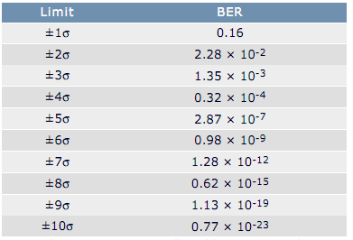
BER & Total Jitter
To find the probability of a data error occurring, the sum of the probabilities of either data edge being in error must be multiplied by the probability of a transition actually occurring
The probability of a transition actually occurring is represented by the average transition density and assumed to be equal to 50% for a typical data stream
Total jitter is nxRJ + DJ
n is the number of standard deviations (σ) of random jitter that will produce a data error
In this expression RJ is in UI (rms) and DJ is in UI
Note that RJ and DJ are both expressed as peak UI – representing the worst case scenario
For a Gaussian distribution (RJ), for example, 1.28E-10% of samples lie outside a 7s limit to one side of the mean

Slide 9
BER & Total Jitter- Example
Assume:
TJ = 0.5UI(pk), DJ = 0.15UI(pk) and RJ = 0.05UI(rms),
What is BER corresponding to the random jitter?
Total jitter is TJ = nxRJ + DJ
We find n = 7 ; corresponding to 7 Standard Deviation (SD)
This is the number of SD of random jitter that will produce a single data error
For a Gaussian distribution (RJ), 1.28E-10% of samples lie outside a 7s limit to one side of the mean.
The total error rate (BER) is then given by samples which lie outside a +/-7s limits to both sides of the mean multiply average transition density (50% of typical data stream)
BER = (1.28E-10% + 1.28E-10%) x 50% = 1.28 E-10%
Remember:
TJ is the total jitter that can be tolerated in order to support the intended BER!

Slide 10
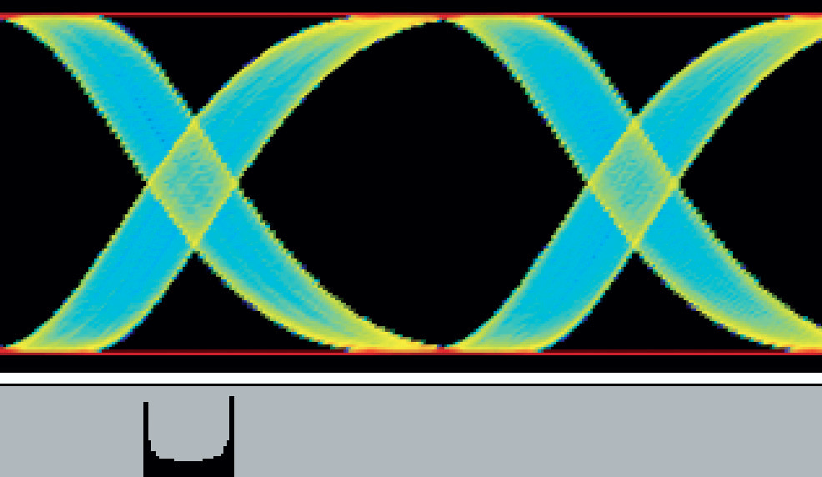
Periodic

Slide 11
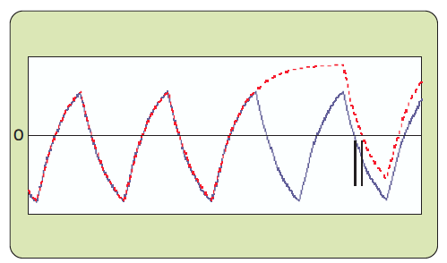
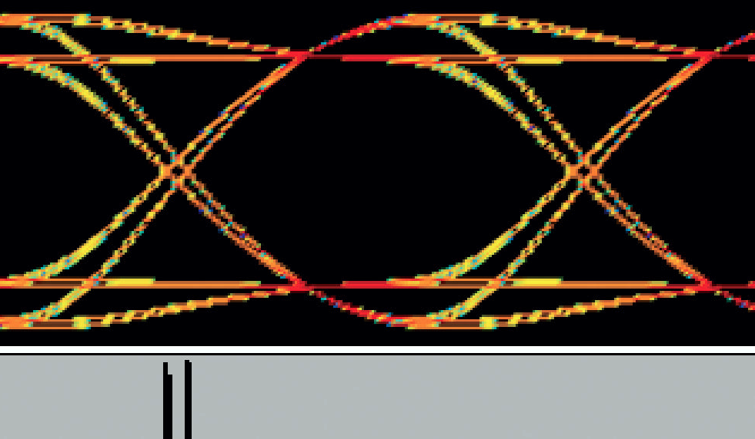
Data Dependent Jitter
101010
Compared with 1010111
This is acting as LPF
→ ISI

Slide 12
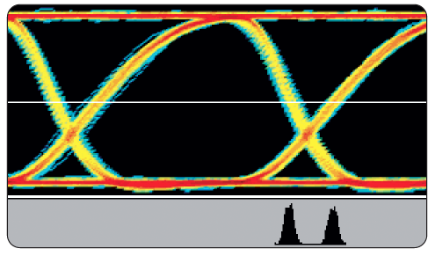
Duty –Cycle Dependent Jitter – Not symmetric

Slide 13
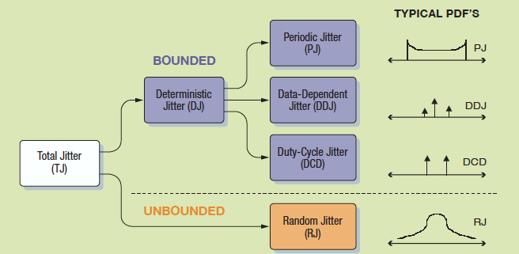
Jitter Separation

Slide 14
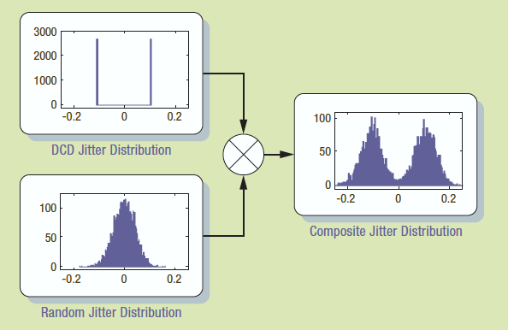
Total Jitter Example

Slide 15
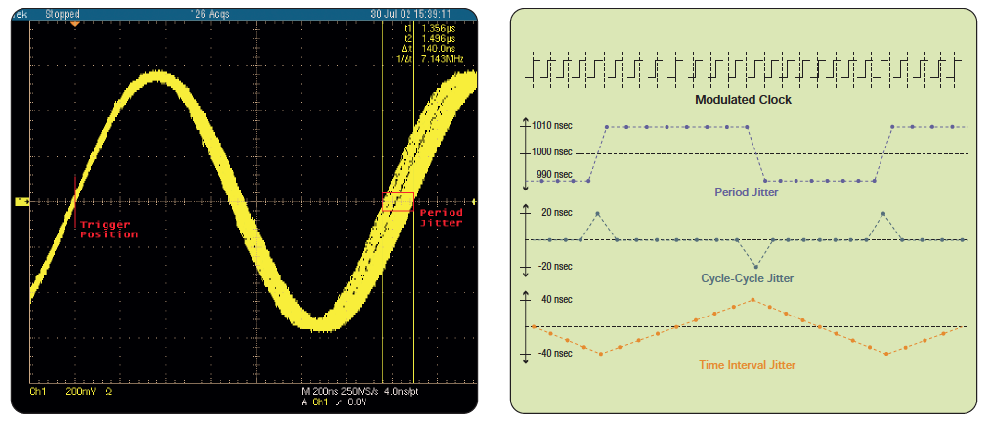
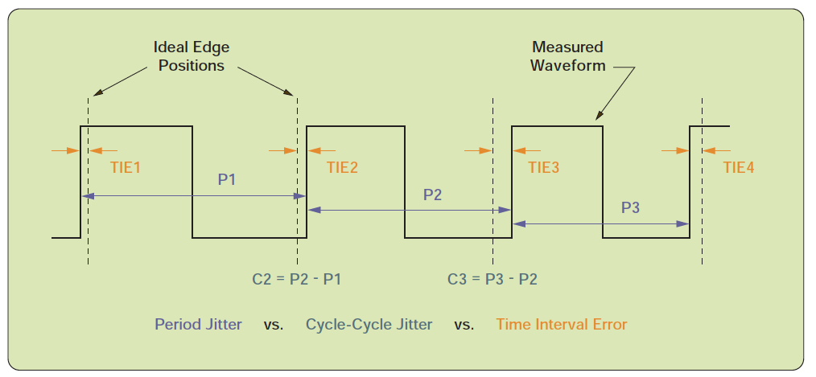
Jitter Measurements
Periodic Jitter

Slide 16
Deterministic Jitter Measurement Techniques
Period Jitter (P1, P2, P3)
Time Interval Error (Per Edge) – if more than 50% → eye is closed!
Cycle-by-Cycle (C2, C3)

Slide 17
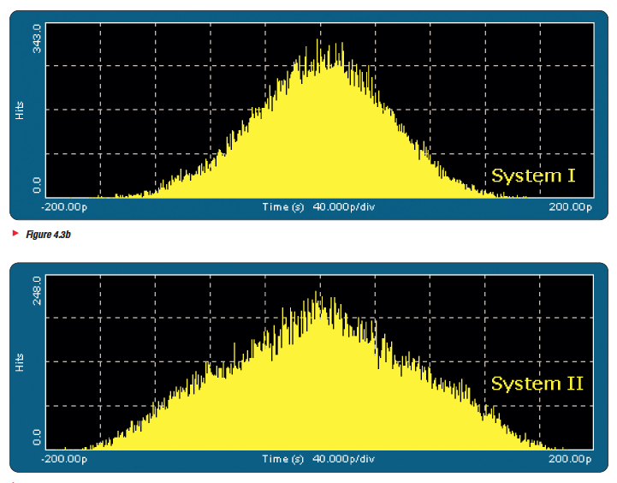
Example
R = 1062.5 Mbps
TIE = 430 psec (0.457 UI)
N (population samples) = 42K
It actually has periodic jitter
components as well!
They are around 0.14 UI –
Cannot be obtained from the pic.

